Slide 1



Tutorial ESWC 2018: From heterogeneous data to RDF graphs and back
Olivier Corby, Catherine Faron Zucker,
Maxime Lefrançois, Antoine Zimmermann
ESWC 2018 tutorial - 4th June 2018

Slide 2
Tutorial ESWC 2018: From heterogeneous data to RDF graphs and back
Olivier Corby, Catherine Faron Zucker,
Maxime Lefrançois, Antoine Zimmermann
ESWC 2018 tutorial - 4th June 2018

Slide 3

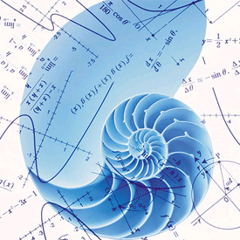
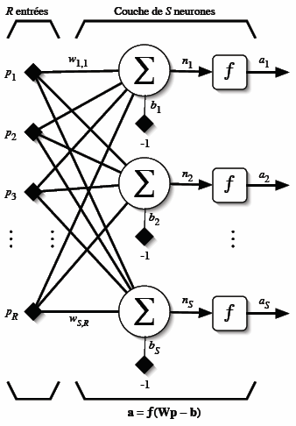
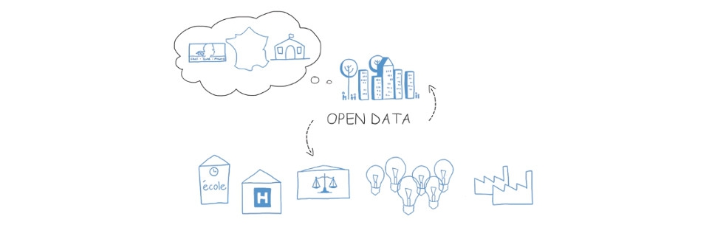

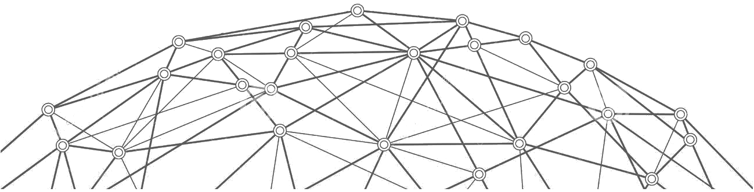
Connected devices
Data
Services
Humans
World Wide Web

Slide 4
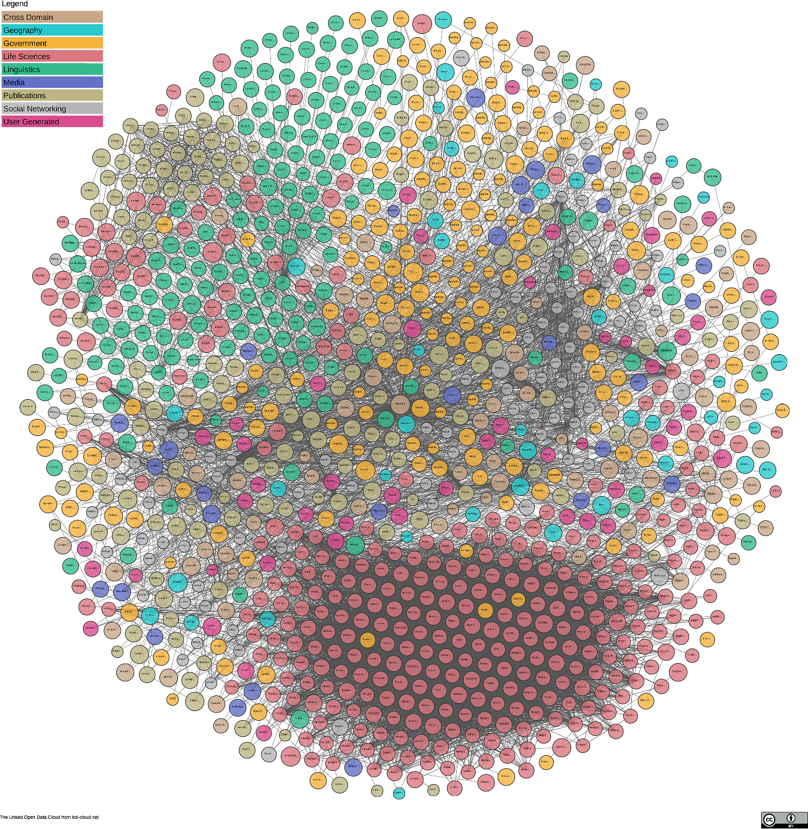
Where is RDF ?
World Wide Web

Slide 5
RDF as a lingua franca
to reach semantic interoperability
integration and querying of data having heterogeneous formats
RDF
Heterogeneous data
RDF lifting
SPARQL-Generate
RDF transformation
STTL

Slide 6
Publications on SPARQL-Generate
Publications on STTL
Corby Olivier, Faron-Zucker Catherine and Gandon Fabien. LDScript: a Linked Data Script Language. International Semantic Web Conference. Springer, Cham, 2017.
Corby Olivier and Faron-Zucker Catherine. STTL: a SPARQL-based transformation language for RDF. International Conference on Web Information Systems and Technologies. 2015.
Lefrançois, Maxime; Zimmermann, Antoine; and Bakerally, Noorani. A SPARQL extension for generating RDF from heterogeneous formats. Extended Semantic Web Conference, ESWC, 2017.
Lefrançois, Maxime; Zimmermann, Antoine; and Bakerally, Noorani. Flexible RDF generation from RDF and heterogeneous data sources with SPARQL-Generate. International Conference on Knowledge Engineering and Knowledge Management, 2016
Maxime Lefrançois, Antoine Zimmermann, Noorani Bakerally. Génération de RDF à partir de sources de données aux formats hétérogènes, Actes de la 17ème conférence Extraction et Gestion des Connaissances, EGC, Jan 2017, Grenoble, France

Slide 7
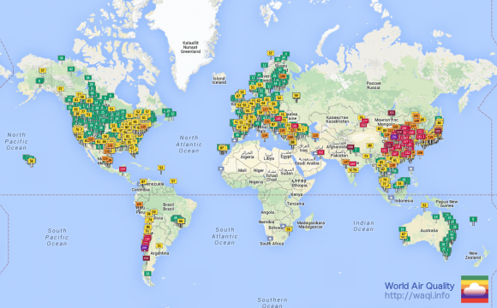
Agenda
Before the break: SPARQL-Generate
After the break: STTL
Management and browsing of existing RDF and non-RDF open data, including real-time sensor data

Slide 8
SPARQL-Generate

Slide 9
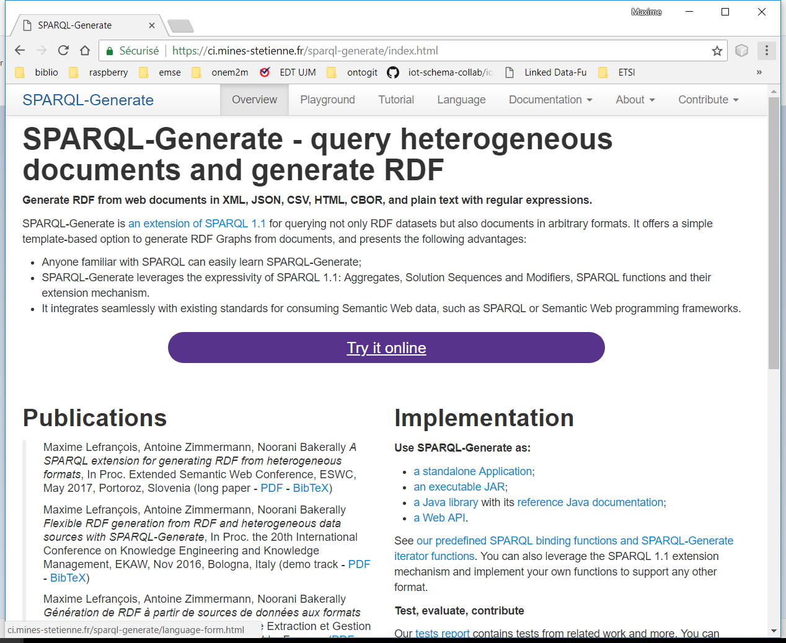

Slide 10
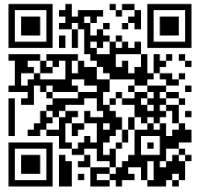
https://eswc2018-sparql-ext.github.io/tutorial/

Slide 11
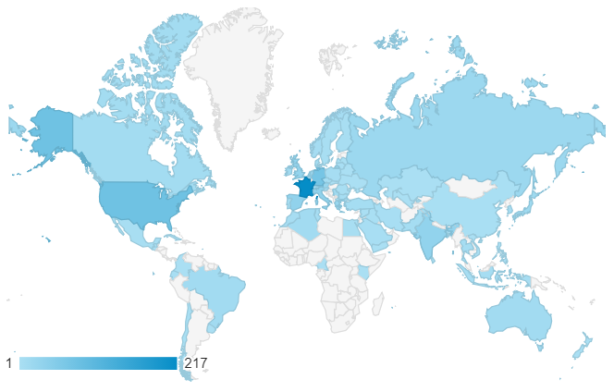
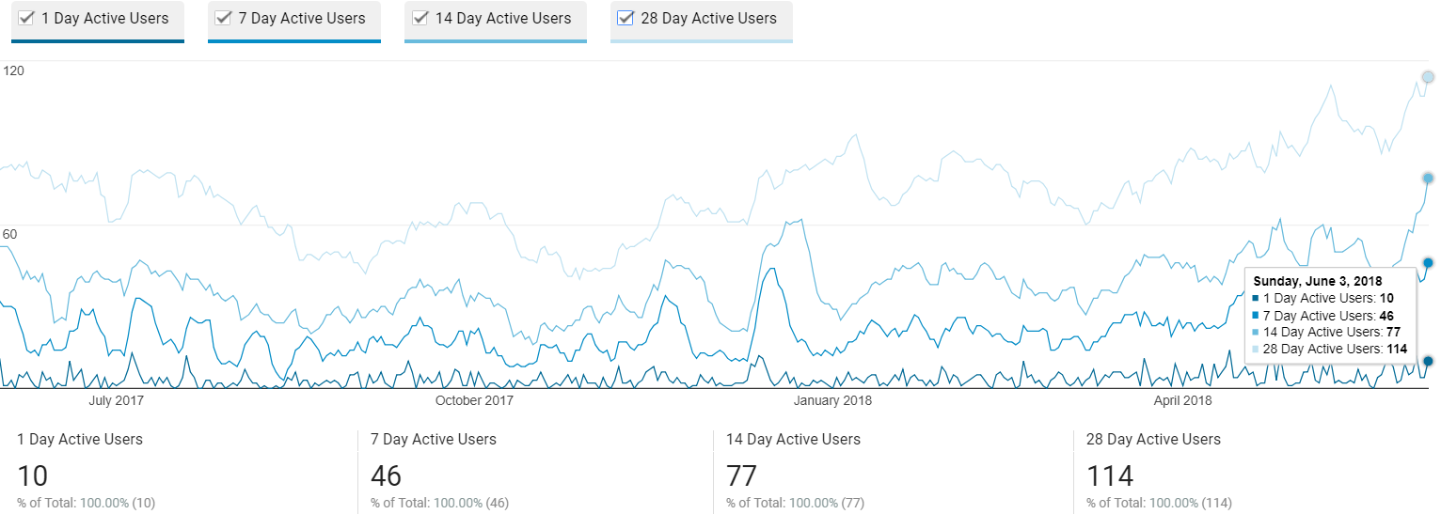
Website analytics

